Slide 1
Chapter 6-11 JavaScript Part1
簡廷因 Ting-Ying Chien
2024.11.13

Slide 2
Outline
Chapter 6 : Introduction to Scripting
Chapter 7 : Control Statements, Part 1
Chapter 8 : Control Statements, Part 2
Chapter 9 : Functions
Chapter 10: Arrays
Chapter 11: Objects

Slide 3
Introduction
JavaScript
Scripting language which is used to enhance the functionality and appearance of web pages.
Before you can run code examples with JavaScript on your computer, you may need to change your browser’s security settings.
IE9 prevents scripts on the local computer from running by default
Firefox, Chrome, Opera, Safari (including on the iPhone) and the Android browser have JavaScript enabled by default.

Slide 4

Your First Script: Displaying a Line of Text with JavaScript in a Web Page
<!DOCTYPE html>
<html>
<head>
<meta charset = "utf-8">
<title>A First Program in JavaScript</title>
<script type = "text/javascript">
document.writeln("<h1>Welcome to JavaScript Programming!</h1>" );
</script>
</head>
<body></body>
</html>

Slide 5
Your First Script: Displaying a Line of Text with JavaScript in a Web Page
All major web browsers contain JavaScript interpreters, which process the commands written in JavaScript.
Often, JavaScripts appear in the <head> section of the HTML5 document
The browser interprets the contents of the <head> section first
The <script> tag indicates to the browser that the text that follows is part of a script. Attribute type specifies the scripting language used in the script—such as text/javascript

Slide 6
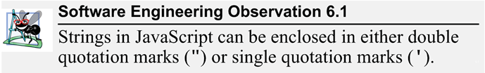
Your First Script: Displaying a Line of Text with JavaScript in a Web Page
A string of characters can be contained between double quotation (") marks (also called a string literal)

Slide 7
Your First Script: Displaying a Line of Text with JavaScript in a Web Page
Browser’s document object represents the HTML5 document currently being displayed in the browser
Allows you to specify HTML5 text to be displayed in the HTML5 document
Browser contains a complete set of objects that allow script programmers to access and manipulate every element of an HTML5 document

Slide 8
Your First Script: Displaying a Line of Text with JavaScript in a Web Page
Object
Resides in the computer’s memory and contains information used by the script
The term object normally implies that attributes (data) and behaviors (methods) are associated with the object
An object’s methods use the attributes’ data to perform useful actions for the client of the object—the script that calls the methods
Attributes - things that the object stores data in, generally variables.
Methods - Functions and Procedures attached to an Object and allowing the object to perform actions

Slide 9
Your First Script: Displaying a Line of Text with JavaScript in a Web Page
The parentheses () following the name of a method contain the arguments that the method requires to perform its task (or its action)
Every statement should end with a semicolon ; (also known as the statement terminator)
JavaScript is case sensitive
Not using the proper uppercase and lowercase letters is a syntax error

Slide 10
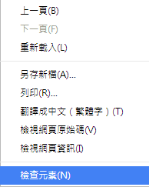
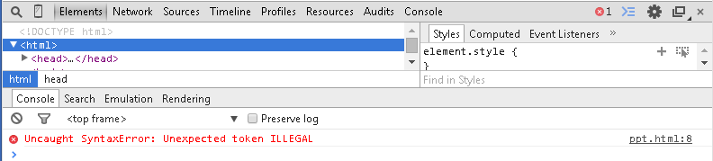
Your First Script: Displaying a Line of Text with JavaScript in a Web Page
The document object’s writeln method
Writes a line of HTML5 text in the HTML5 document
How to debug?

Slide 11
Modifying Your First Script
<!DOCTYPE html>
<html>
<head>
<meta charset = "utf-8">
<title>Printing a Line with Multiple Statements</title>
<script>
document.write( "<h1 style = 'color: magenta'>" );
document.write( "Welcome to JavaScript " +
"Programming!</h1>" );
</script>
</head><body></body>
</html>

Slide 12
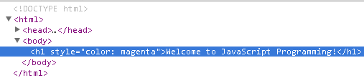
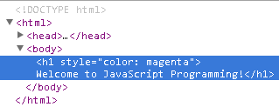
Modifying Your First Script
Method write displays a string like writeln, but does not position the output cursor in the HTML5 document at the beginning of the next line after writing its argument
The + operator (called the "concatenation operator" when used in this manner) joins two strings together
write
writeln

Slide 13
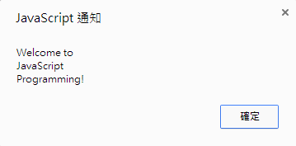

Modifying Your First Script
<!DOCTYPE html>
<html>
<head>
<meta charset = "utf-8">
<title>Printing Multiple Lines in a Dialog Box</title>
<script>
window.alert( "Welcome to\nJavaScript\nProgramming!" );
</script>
</head>
<body>
<p>Reload the page to run this script again.</p>
</body>
</html>

Slide 14
Modifying Your First Script
Displaying Text in an Alert Dialog
Dialogs
Useful to display information in windows that "pop up" on the screen to grab the user’s attention
Typically used to display important messages to the user browsing the web page
Browser’s window object uses method alert to display an alert dialog
Method alert requires as its argument the string to be displayed

Slide 15
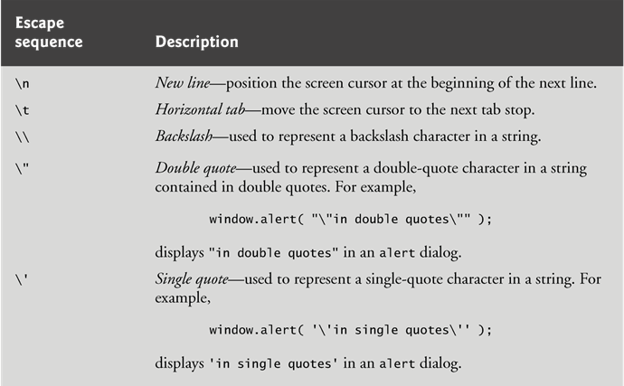
Modifying Your First Script
Escape Sequences
When a backslash is encountered in a string of characters, the next character is combined with the backslash to form an escape sequence. The escape sequence \n is the newline character. It causes the cursor in the HTML5 document to move to the beginning of the next line.

Slide 16
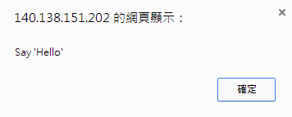
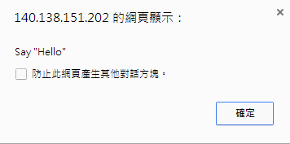
Exercise
Escape Sequences
Single double v.s double quotation

Slide 17
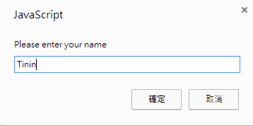
Dynamic Welcome Page
<!DOCTYPE html>
<html>
<head>
<meta charset = "utf-8">
<title>Using Prompt and Alert Boxes</title>
<script>
var name; // string entered by the user
// read the name from the prompt box as a string
name = window.prompt( "Please enter your name" );
document.writeln( "<h1>Hello " + name +
", welcome to JavaScript programming!</h1>" );
</script>
</head><body></body>
</html>

Slide 18
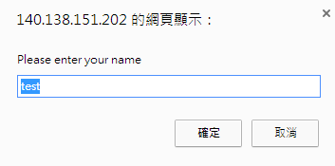
Dynamic Welcome Page
The script uses another predefined dialog box from the window object—a prompt dialog—which allows the user to enter a value that the script can use.
The first argument is a message (called a prompt) that directs the user to take a specific action.
The optional second argument is the default string to display in the text field.
Script can then use the value that the user inputs.
name = window.prompt( "Please enter your name", "test" );

Slide 19
Dynamic Welcome Page
Keywords are words with special meaning in JavaScript
Keyword var
Used to declare the names of variables
A variable is a location in the computer’s memory where a value can be stored for use by a script
All variables have a name, type and value, and should be declared with a var statement before they are used in a script
A variable name can be any valid identifier consisting of letters, digits, underscores ( _ ) and dollar signs ($) that does not begin with a digit and is not a reserved JavaScript keyword.

Slide 20
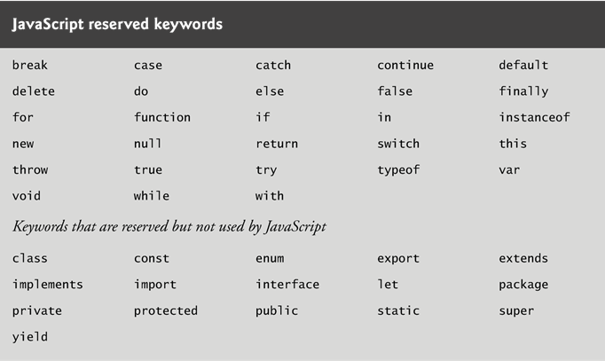
Dynamic Welcome Page

Slide 21
Dynamic Welcome Page
Declarations end with a semicolon (;) and can be split over several lines, with each variable in the declaration separated by a comma (forming a comma-separated list of variable names)
Several variables may be declared in one declaration or in multiple declarations.
Comments
A single-line comment begins with the characters // and terminates at the end of the line
Comments do not cause the browser to perform any action when the script is interpreted; rather, comments are ignored by the JavaScript interpreter
Multiline comments begin with delimiter /* and end with delimiter */
All text between the delimiters of the comment is ignored by the interpreter.

Slide 22
Dynamic Welcome Page
A variable is assigned a value with an assignment statement, using the assignment operator, =.
The = operator is called a binary operator, because it has two operands.

Slide 23
Variables
JavaScript does not require variables to have a type before they can be used in a script
A variable in JavaScript can contain a value of any data type, and in many situations, JavaScript automatically converts between values of different types for you
JavaScript is referred to as a loosely typed language
When a variable is declared in JavaScript, but is not given a value, it has an undefined value.
Attempting to use the value of such a variable is normally a logic error.
When variables are declared, they are not assigned default values, unless specified otherwise by the programmer.
To indicate that a variable does not contain a value, you can assign the value null to it.

Slide 24
Variables
null keyword
Signifies that a variable has no value
null is not a string literal, but rather a predefined term indicating the absence of value
Writing a null value to the document, however, displays the word “null”

Slide 25
Adding Integers
<!DOCTYPE html>
<html>
<head>
<meta charset = "utf-8">
<title>An Addition Program</title>
<script>
var firstNumber; // first string entered by user
var secondNumber; // second string entered by user
var number1; // first number to add
var number2; // second number to add
var sum; // sum of number1 and number2
// read in first number from user as a string
firstNumber = window.prompt( "Enter first integer" );
// read in second number from user as a string
secondNumber = window.prompt( "Enter second integer" );
// convert numbers from strings to integers
number1 = parseInt( firstNumber );
number2 = parseInt( secondNumber );
sum = number1 + number2; // add the numbers
// display the results
document.writeln( "<h1>The sum is " + sum + "</h1>" );
</script>
</head><body></body>
</html>

Slide 26
Adding Integers
Function parseInt
converts its string argument to an integer
JavaScript has a version of the + operator for string concatenation that enables a string and a value of another data type (including another string) to be concatenated
Number() | Converts an object's value to a number
parseFloat() | Parses a string and returns a floating point number
parseInt() | Parses a string and returns an integer
String() | Converts an object's value to a string

Slide 27
Arithmetic
The basic arithmetic operators (+, -, *, /, and %) are binary operators, because they each operate on two operands
JavaScript provides the remainder operator, %, which yields the remainder after division
Arithmetic expressions in JavaScript must be written in straight-line form to facilitate entering programs into the computer

Slide 28
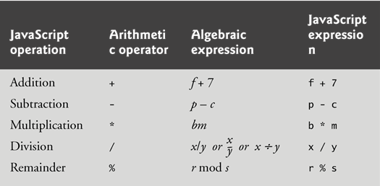
Arithmetic

Slide 29
Control Statements
JavaScript provides three selection structures.
The if statement either performs (selects) an action if a condition is true or skips the action if the condition is false.
Called a single-selection statement because it selects or ignores a single action or group of actions.
The if…else statement performs an action if a condition is true and performs a different action if the condition is false.
Double-selection statement because it selects between two different actions or group of actions.
The switch statement performs one of many different actions, depending on the value of an expression.
Multiple-selection statement because it selects among many different actions or groups of actions.

Slide 30
if Selection Statement
if statement allows a script to make a decision based on the truth or falsity of a condition
If the condition is met (i.e., the condition is true), the statement in the body of the if statement is executed
If the condition is not met (i.e., the condition is false), the statement in the body of the if statement is not executed
Conditions in if statements can be formed by using the equality operators and relational operators

Slide 31
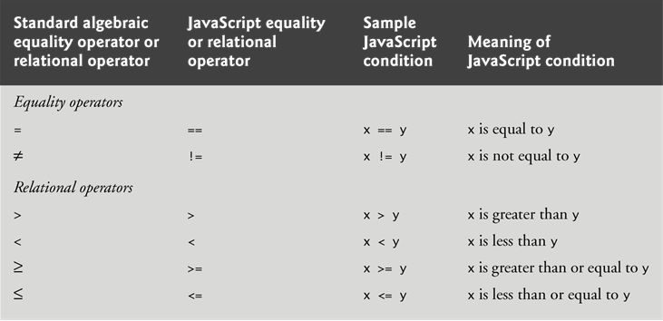
if Selection Statement
Equality and Relational Operators

Slide 32
if Selection Statement
Logical Operators
Logical operators can be used to form complex conditions by combining simple conditions
&& (logical AND)
|| (logical OR)
! (logical NOT, also called logical negation)
JavaScript evaluates to false or true all expressions that include relational operators, equality operators and/or logical operators
Description | Operator
and | &&
or | ||
not | !

Slide 33
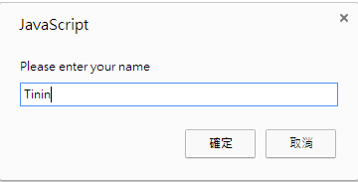
if Selection Statement
<!DOCTYPE html>
<html>
<head>
<meta charset = "utf-8">
<title>Using Relational Operators</title>
<script>
var name; // string entered by the user
var now = new Date(); // current date and time
var hour = now.getHours(); // current hour (0-23)
name = window.prompt( "Please enter your name" );
if ( hour < 12 ) // determine whether it's morning
document.write( "<h1>Good Morning, " );
if ( hour >= 12 ) // determine whether the time is PM
{
hour = hour - 12; // convert to a 12-hour clock
if ( hour < 6 ) // determine whether it is before 6 PM
document.write( "<h1>Good Afternoon, " );
if ( hour >= 6 ) // determine whether it is after 6 PM
document.write( "<h1>Good Evening, " );
} // end if
document.writeln( name +
", welcome to JavaScript programming!</h1>" );
</script>
</head><body></body>
</html>

Slide 34
if Selection Statement
Date object
Used acquire the current local time
Create a new instance of an object by using the new operator followed by the type of the object, Date, and a pair of parentheses

Slide 35
if Selection Statement
Date Get Methods
getDate() | Get the day as a number (1-31)
getDay() | Get the weekday a number (0-6)
getFullYear() | Get the four digit year (yyyy)
getHours() | Get the hour (0-23)
getMilliseconds() | Get the milliseconds (0-999)
getMinutes() | Get the minutes (0-59)
getMonth() | Get the month (0-11)
getSeconds() | Get the seconds (0-59)
getTime() | Get the time (milliseconds since January 1, 1970)

Slide 36
if Selection Statement
The JavaScript interpreter ignores white-space characters
blanks, tabs and newlines used for indentation and vertical spacing
A decision can be made on any expression that evaluates to a value of JavaScript’s boolean type (i.e., any expression that evaluates to true or false).
The indentation convention you choose should be carefully applied throughout your scripts
It is difficult to read scripts that do not use uniform spacing conventions

Slide 37
if...else Selection Statement
Allows you to specify that different actions should be performed when the condition is true and when the condition is false.

Slide 38
if...else Selection Statement
Conditional operator (?:)
Closely related to the if…else statement
JavaScript’s only ternary operator—it takes three operands
The operands together with the ?: operator form a conditional expression
The first operand is a boolean expression
The second is the value for the conditional expression if the boolean expression evaluates to true
Third is the value for the conditional expression if the boolean expression evaluates to false

Slide 39
Nested if…else statements
The JavaScript interpreter always associates an else with the previous if, unless told to do otherwise by the placement of braces ({})
The if selection statement expects only one statement in its body
To include several statements, enclose the statements in braces ({ and })
A set of statements contained within a pair of braces is called a block

Slide 40
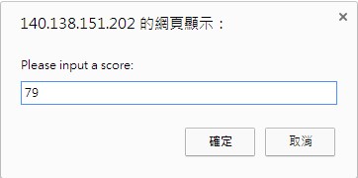

Exercise
Input : Midterm Score
Output : Grading
80 + : A
70 ~ 79 : B
60 ~ 69 : C
59 - : D

Slide 41
switch Multiple-Selection Statement
switch statement
Consists of a series of case labels and an optional default case
When control reaches a switch statement
The script evaluates the controlling expression in the parentheses
Compares this value with the value in each of the case labels
If the comparison evaluates to true, the statements after the case label are executed in order until a break statement is reached

Slide 42
switch Multiple-Selection Statement
The break statement is used as the last statement in each case to exit the switch statement immediately
The default case allows you to specify a set of statements to execute if no other case is satisfied
Usually the last case in the switch statement

Slide 43
Switch Selection Statement
<!DOCTYPE html>
<html>
<head>
<meta charset = "utf-8">
<title>Using Relational Operators</title>
<script>
var str;
var now = new Date();
var day = now.getDay();
switch (day) {
case 0:
str = "Sunday";
break;
case 1:
str = "Monday";
break;
case 2:
str = "Tuesday";
break;
case 3:
str = "Wednesday";
break;
case 4:
str = "Thursday";
break;
case 5:
str = "Friday";
break;
case 6:
str = "Saturday";
break;
}
document.writeln( "<h1>Today is " + str + ", welcome to JavaScript programming!</h1>" );
</script>
</head><body></body>
</html>

Slide 44
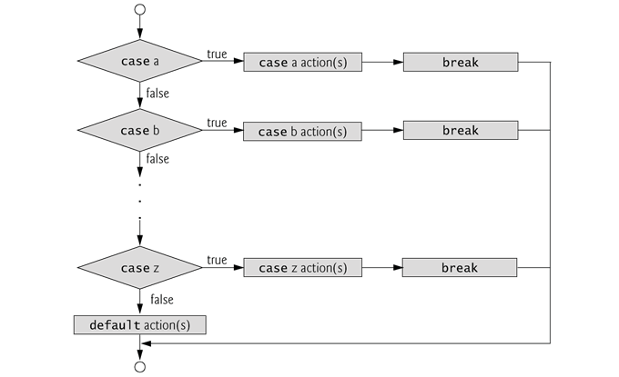
switch Multiple-Selection Statement

Slide 45
Control Statements
JavaScript provides four repetition statements, namely, while, do…while, for and for…in.

Slide 46
while Repetition Statement
while
Allows you to specify that an action is to be repeated while some condition remains true
The body of a loop may be a single statement or a block
Eventually, the condition becomes false and repetition terminates

Slide 47
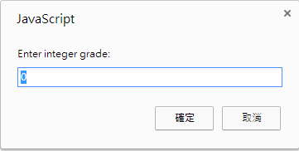

while Repetition Statement
<!DOCTYPE html>
<html>
<head>
<meta charset = "utf-8">
<title>Class Average Program</title>
<script>
var total; // sum of grades
var gradeCounter; // number of grades entered
var grade; // grade typed by user (as a string)
var gradeValue; // grade value (converted to intetger)
var average; // average of all grades
total = 0; // clear total
gradeCounter = 1; // prepare to loop
while ( gradeCounter <= 10 ) // loop 10 times
{
grade = window.prompt( "Enter integer grade:", "0" );
gradeValue = parseInt( grade );
total = total + gradeValue;
gradeCounter = gradeCounter + 1;
} // end while
average = total / 10; // calculate the average
document.writeln( "<h1>Class average is " + average + "</h1>" );
</script>
</head><body></body>
</html>

Slide 48
while Repetition Statement
JavaScript represents all numbers as floating-point numbers in memory
Floating-point numbers often develop through division
The computer allocates only a fixed amount of space to hold such a value, so the stored floating-point value can only be an approximation

Slide 49
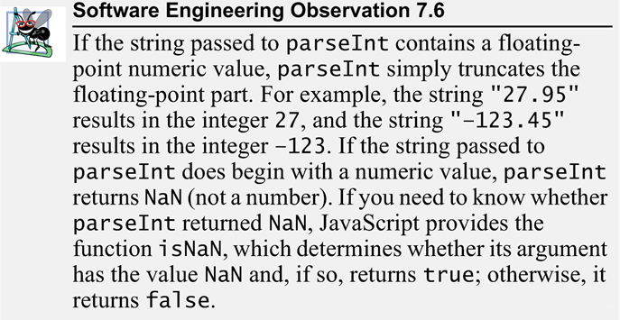
while Repetition Statement

Slide 50


Exercise
Get comic automatically
http://www.cartoonmad.com/comic/1152.html
First page
Last page

Slide 51
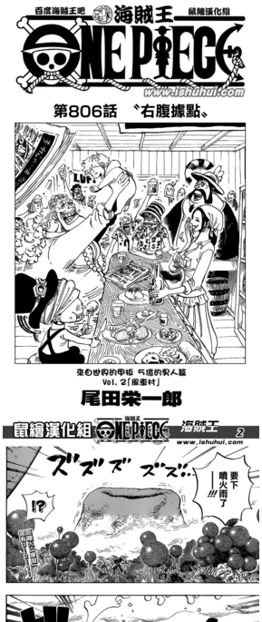
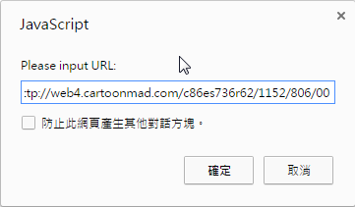
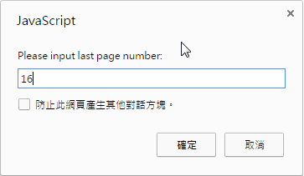
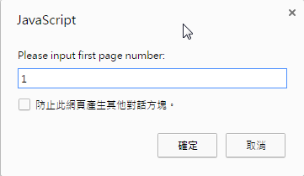
Exercise
Get comic automatically
Input:
URL
First page number
Last page number

Slide 52
Exercise
學伴通
Input :
From Student ID
To Student ID
Portal ->任一門課->學生/助教->檢視網頁原始碼
<img src="https://portalx.yzu.edu.tw/PortalSocialVB/Include/ShowImage.aspx?ShowType=UserPic&UserAccount=s'+sid+'&UserPictureName=" height="120" width="93"></td>
連結已失效, 找尋新的連結中

Slide 53
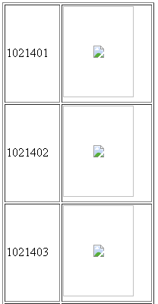
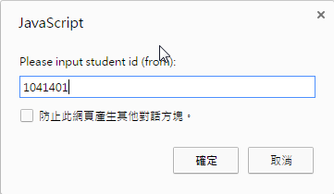
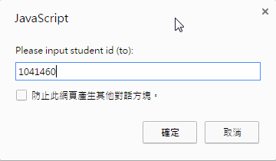
Exercise
學伴通

Slide 54
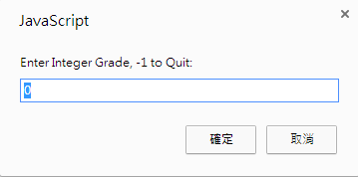
while Repetition Statement
<!DOCTYPE html>
<html>
<head>
<meta charset = "utf-8">
<title>Class Average Program: Sentinel-controlled Repetition</title>
<script>
var total;
var gradeCounter;
var grade;
var gradeValue;
var average;
total = 0;
gradeCounter = 0;
grade = window.prompt( "Enter Integer Grade, -1 to Quit:", "0" );
gradeValue = parseInt( grade );
while ( gradeValue != -1 )
{
total = total + gradeValue;
gradeCounter = gradeCounter + 1;
grade = window.prompt( "Enter Integer Grade, -1 to Quit:", "0" );
gradeValue = parseInt( grade );
}
if ( gradeCounter != 0 )
{
average = total / gradeCounter;
document.writeln( "<h1>Class average is " + average + "</h1>" );
}
else
document.writeln( "<p>No grades were entered</p>" );
</script>
</head><body></body>
</html>

Slide 55
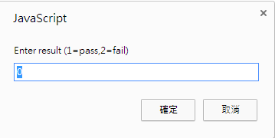
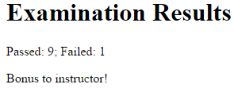
Nested Control Statements
<html>
<head>
<meta charset = "utf-8">
<title>Analysis of Examination Results</title>
<script>
var passes = 0;
var failures = 0;
var student = 1;
var result;
while ( student <= 10 )
{
result = window.prompt( "Enter result (1=pass,2=fail)", "0" );
if ( result == "1" )
passes = passes + 1;
else
failures = failures + 1;
student = student + 1;
}
document.writeln( "<h1>Examination Results</h1>" );
document.writeln( "<p>Passed: " + passes +
"; Failed: " + failures + "</p>" );
if ( passes > 8 )
document.writeln( "<p>Bonus to instructor!</p>" );
</script>
</head><body></body>
</html>

Slide 56
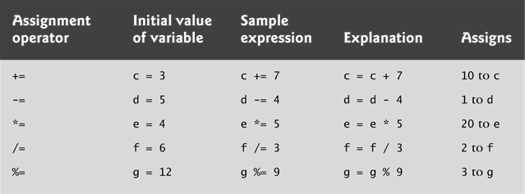
Assignment Operators
JavaScript provides the arithmetic assignment operators +=, -=, *=, /= and %=, which abbreviate certain common types of expressions.

Slide 57
Increment and Decrement Operators
The increment operator, ++, and the decrement operator, --, increment or decrement a variable by 1, respectively.
If the operator is prefixed to the variable, the variable is incremented or decremented by 1, then used in its expression.
If the operator is postfixed to the variable, the variable is used in its expression, then incremented or decremented by 1.

Slide 58
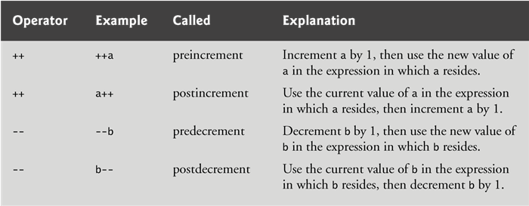
Increment and Decrement Operators

Slide 59
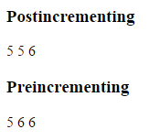
Increment and Decrement Operators
<!DOCTYPE html>
<html>
<head>
<meta charset = "utf-8">
<title>Preincrementing and Postincrementing</title>
<script>
var c;
c = 5;
document.writeln( "<h3>Postincrementing</h3>" );
document.writeln( "<p>" + c ); // prints 5
document.writeln( " " + c++ );
document.writeln( " " + c + "</p>" ); // prints 6
c = 5;
document.writeln( "<h3>Preincrementing</h3>" );
document.writeln( "<p>" + c ); // prints 5
document.writeln( " " + ++c );
document.writeln( " " + c + "</p>" ); // prints 6
</script>
</head><body></body>
</html>
c++ : 先印再加
++c : 先加再印

Slide 60
while Repetition Statement
HTML5 allows either single quotes (') or double quotes (") to be placed around the value specified for an attribute
JavaScript allows single quotes to be placed in a string literal

Slide 61
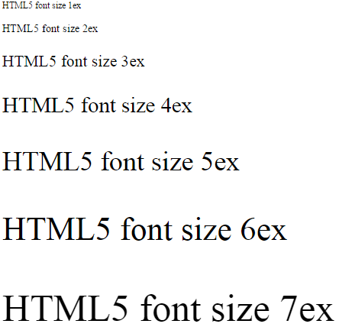
while Repetition Statement
<!DOCTYPE html>
<html>
<head>
<meta charset= "utf-8">
<title>Counter-Controlled Repetition</title>
<script>
var counter = 1;
while ( counter <= 7)
{
document.writeln( "<p style = 'font-size: " +
counter + "ex'>HTML5 font size " + counter + "ex</p>" );
++counter;
}
</script>
</head><body></body>
</html>
"<p style = 'font-size: " + counter + "ex'>HTML5 font size " + counter + "ex</p>"

Slide 62
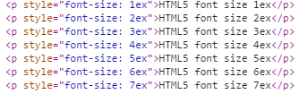
while Repetition Statement
"<p style = 'font-size: " + counter + "ex'>HTML5 font size " + counter + "ex</p>"
Chrome -> 檢查元素

Slide 63
for Repetition Statement
for statement
Specifies each of the items needed for counter-controlled repetition with a control variable
Can use a block to put multiple statements into the body
If the loop’s condition uses a < or > instead of a <= or >=, or vice-versa, it can result in an off-by-one error
for statement header contains three expressions
Initialization
Condition
Increment Expression

Slide 64
for Repetition Statement
The increment expression in the for statement acts like a stand-alone statement at the end of the body of the for statement
Place only expressions involving the control variable in the initialization and increment sections of a for statement

Slide 65
for Repetition Statement
<!DOCTYPE html>
<html>
<head>
<meta charset="utf-8">
<title>Counter-Controlled Repetition</title>
<script>
for ( var counter = 1; counter <= 7; ++counter )
document.writeln( "<p style = 'font-size: " +
counter + "ex'>HTML5 font size " + counter + "ex</p>" );
</script>
</head><body></body>
</html>

Slide 66
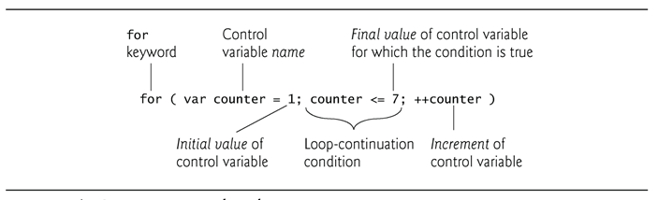
for Repetition Statement
The three expressions in the for statement are optional
The two semicolons in the for statement are required
The initialization, loop-continuation condition and increment portions of a for statement can contain arithmetic expressions

Slide 67
for Repetition Statement
The part of a script in which a variable name can be used is known as the variable’s scope
The “increment” of a for statement may be negative, in which case it is called a decrement and the loop actually counts downward
If the loop-continuation condition initially is false, the body of the for statement is not performed
Execution proceeds with the statement following the for statement

Slide 68
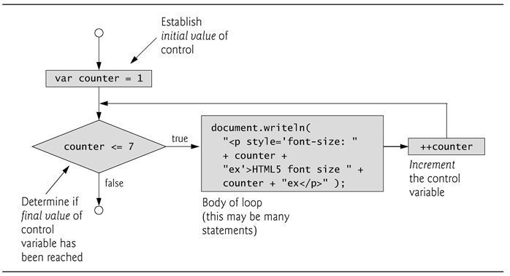
for Repetition Statement

Slide 69

for Repetition Statement
<!DOCTYPE html>
<html>
<head>
<meta charset = "utf-8">
<title>Sum the Even Integers from 2 to 100</title>
<script>
var sum = 0;
for ( var number = 2; number <= 100; number += 2)
sum += number;
document.writeln( "The sum of the even integers " +
"from 2 to 100 is " + sum );
</script>
</head><body></body>
</html>

Slide 70
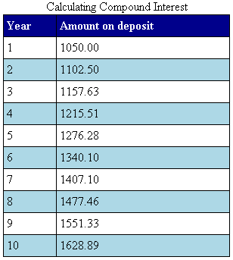
for Repetition Statement (CSS)
<!DOCTYPE html>
<html>
<head>
<meta charset = "utf-8">
<title>Calculating Compound Interest</title>
<style type = "text/css">
table { width: 300px;
border-collapse:collapse;
background-color: lightblue; }
table, td, th { border: 1px solid black;
padding: 4px; }
th { text-align: left;
color: white;
background-color: darkblue; }
tr.oddrow { background-color: white; }
</style>
<script>
var amount;
var principal = 1000.00;
var rate = 0.05;
document.writeln( "<table>" );
document.writeln( "<caption>Calculating Compound Interest</caption>" );
document.writeln( "<thead><tr><th>Year</th>" );
document.writeln( "<th>Amount on deposit</th>" );
document.writeln( "</tr></thead><tbody>" );
for ( var year = 1; year <= 10; ++year )
{
amount = principal * Math.pow( 1.0 + rate, year );
if ( year % 2 !== 0 )
document.writeln( "<tr class='oddrow'><td>" + year +
"</td><td>" + amount.toFixed(2) + "</td></tr>" );
else
document.writeln( "<tr><td>" + year +
"</td><td>" + amount.toFixed(2) + "</td></tr>" );
}
document.writeln( "</tbody></table>" );
</script>
</head><body></body>
</html>
Math.pow(x,y) : 次方x^{y}
.toFixed(x): 固定小數點後x位

Slide 71
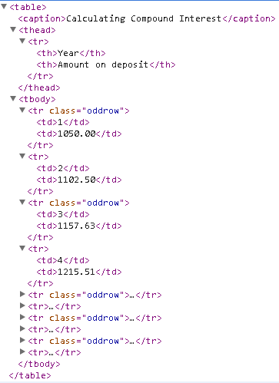
for Repetition Statement (CSS)
<style type = "text/css">
table { width: 300px;
border-collapse:collapse;
background-color: lightblue; }
table, td, th { border: 1px solid black;
padding: 4px; }
th { text-align: left;
color: white;
background-color: darkblue; }
tr.oddrow { background-color: white; }
</style>

Slide 72
for Repetition Statement (CSS)
JavaScript does not include an exponentiation operator
Math object’s pow method for this purpose. Math.pow(x, y) calculates the value of x raised to the yth power.

Slide 73
switch Multiple-Selection Statement
The break statement is used as the last statement in each case to exit the switch statement immediately
The default case allows you to specify a set of statements to execute if no other case is satisfied
Usually the last case in the switch statement

Slide 74
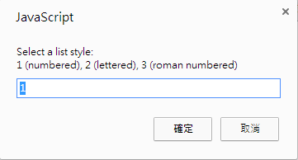
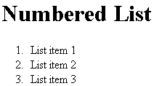
<!DOCTYPE html>
<html>
<head>
<meta charset = "utf-8">
<title>Switching between HTML5 List Formats</title>
<script>
var choice; // user's choice
var startTag; // starting list item tag
var endTag = "</ol>"; // ending list item tag
var validInput = true; // true if input valid else false
var listType; // type of list as a string
choice = window.prompt( "Select a list style:\n" + "1 (numbered), 2 (lettered), 3 (roman numbered)", "1" );
switch ( choice )
{
case "1":
startTag = "<ol>";
listType = "<h1>Numbered List</h1>";
break;
case "2":
startTag = "<ol style = 'list-style-type: upper-alpha'>";
listType = "<h1>Lettered List</h1>";
break;
case "3":
startTag = "<ol style = 'list-style-type: upper-roman'>";
listType = "<h1>Roman Numbered List</h1>";
break;
default:
validInput = false;
break;
}
if ( validInput == true )
{
document.writeln( listType + startTag );
for ( var i = 1; i <= 3; ++i )
document.writeln( "<li>List item " + i + "</li>" );
document.writeln( endTag );
}
else
document.writeln( "Invalid choice: " + choice );
</script>
</head><body></body>
</html>

Slide 75
switch Multiple-Selection Statement
CSS property list-style-type
Allows you to set the numbering system for a list
Possible values include
decimal (numbers—the default)
lower-roman (lowercase roman numerals)
i, ii, iii
upper-roman (uppercase roman numerals)
I, II, III
lower-alpha (lowercase letters)
a, b, c
upper-alpha (uppercase letters)
A, B, C
others

Slide 76
do…while Repetition Statement
do…while statement
tests the loop-continuation condition after the loop body executes
The loop body always executes at least once

Slide 77
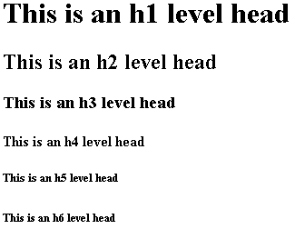
do…while Repetition Statement
<!DOCTYPE html>
<html>
<head>
<meta charset = "utf-8">
<title>Using the do...while Repetition Statement</title>
<script>
var counter = 1;
do {
document.writeln( "<h" + counter + ">This is " +
"an h" + counter + " level head" + "</h" +
counter + ">" );
++counter;
} while ( counter <= 6 );
</script>
</head><body></body>
</html>

Slide 78
break and continue Statements
break statement in a while, for, do…while or switch statement
Causes immediate exit from the statement
Execution continues with the next statement in sequence
break statement common uses
Escape early from a loop
Skip the remainder of a switch statement

Slide 79
break and continue Statements
continue statement in a while, for or do…while
skips the remaining statements in the body of the statement and proceeds with the next iteration of the loop
In while and do…while statements, the loop-continuation test evaluates immediately after the continue statement executes
In for statements, the increment expression executes, then the loop-continuation test evaluates

Slide 80
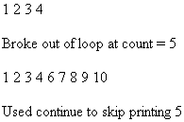
break and continue Statements
<!DOCTYPE html>
<html>
<head>
<meta charset = "utf-8">
<title>
Using the break Statement in a for Statement
</title>
<script>
for ( var count = 1; count <= 10; ++count )
{
if ( count == 5 )
break;
document.writeln( count + " " );
}
document.writeln("<p>Broke out of loop at count = " + count + "</p>" );
for ( var count = 1; count <= 10; ++count )
{
if ( count == 5 )
continue;
document.writeln( count + " " );
}
document.writeln( "<p>Used continue to skip printing 5</p>" );
</script>
</head><body></body>
</html>

Slide 81
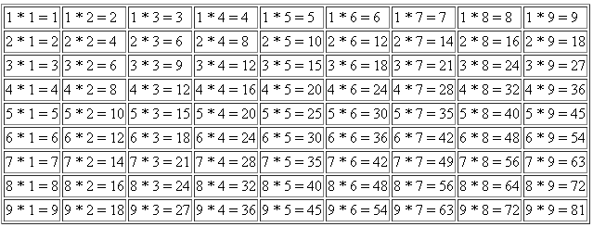
Nested loop
<!DOCTYPE html>
<html>
<head>
<meta charset = "utf-8">
<title>
Nested For Loop
</title>
<script>
document.writeln( "<table border=1>");
for ( var i = 1; i <= 9; i++ )
{
document.writeln( "<tr>");
for ( var j = 1; j <= 9; j++ )
{
var res= i*j;
document.writeln( "<td>"+i+" * "+j+" = "+res+"</td>");
}
document.writeln( "</tr>");
}
document.writeln( "</table>" );
</script>
</head><body></body>
</html>

Slide 82
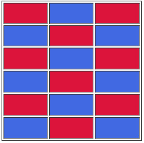
Exercise
Hint :
Javascript
<td style="background-color:royalblue;">
<td style=" background-color:crimson; ">

Slide 83
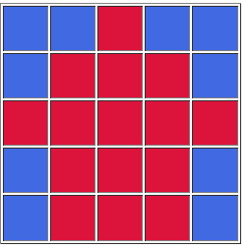
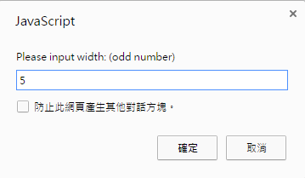
Exercise
Hint:
table width = input * 50
<td style="background-color:royalblue;">
<td style=" background-color:crimson; ">
(input+1 )/2
Always = 3

Slide 84
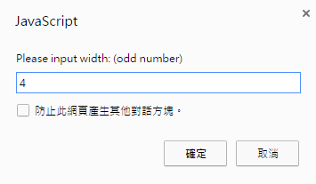
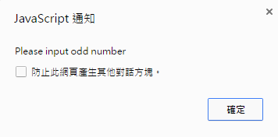
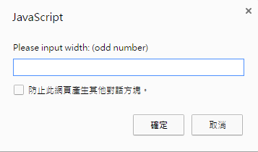
Exercise
If the input is an even number
Alert message
Input again

Slide 85
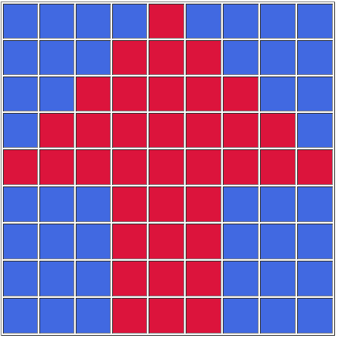

Exercise
Example
Input=7, 9

Slide 86
Functions

Slide 87
Introduction
To develop and maintain a large program
construct it from small simple pieces
divide and conquer

Slide 88
Introduction
The format of a function definition is
return statement
passes information from inside a function back to the point in the program where it was called
A function must be called explicitly for the code in its body to execute
function function-name( parameter-list )
{
declarations and statements
}

Slide 89

Programmer-Defined Function square
<!DOCTYPE html>
<html>
<head>
<meta charset = "utf-8">
<title>A Programmer-Defined square Function</title>
<style type = "text/css">
p { margin: 0; }
</style>
<script>
document.writeln( "<h1>Square the numbers from 1 to 10</h1>" );
for ( var x = 1; x <= 10; ++x )
{
document.writeln( "<p>The square of " + x + " is "
+ square( x ) + "</p>" );
}
function square( y )
{
return y * y;
}
</script>
</head><body></body>
</html>

Slide 90
Programmer-Defined Function square
Three ways to return control to the point at which a function was invoked
Reaching the function-ending right brace
Executing the statement return;
Executing the statement “return expression;” to return the value of expression to the caller
When a return statement executes, control returns immediately to the point at which the function was invoked

Slide 91




Programmer-Defined Function maximum
<!DOCTYPE html>
<html>
<head>
<meta charset = "utf-8">
<title>Maximum of Three Values</title>
<style type = "text/css">
p { margin: 0; }
</style>
<script>
var input1 = window.prompt( "Enter first number", "0" );
var input2 = window.prompt( "Enter second number", "0" );
var input3 = window.prompt( "Enter third number", "0" );
var value1 = parseFloat( input1 );
var value2 = parseFloat( input2 );
var value3 = parseFloat( input3 );
var maxValue = maximum( value1, value2, value3 );
document.writeln( "<p>First number: " + value1 + "</p>" +
"<p>Second number: " + value2 + "</p>" +
"<p>Third number: " + value3 + "</p>" +
"<p>Maximum is: " + maxValue + "</p>" );
function maximum( x, y, z )
{
return Math.max( x, Math.max( y, z ) );
}
</script>
</head><body></body>
</html>

Slide 92
Programmer-Defined Function maximum
Math Object
abs(x) | Returns the absolute value of x
random() | Returns a random number between 0 and 1
round(x) | Rounds x to the nearest integer
sin(x) | Returns the sine of x (x is in radians)
cos(x) | Returns the cosine of x (x is in radians)
tan(x) | Returns the tangent of an angle
asin(x) | Returns the arcsine of x, in radians
acos(x) | Returns the arccosine of x, in radians
atan(x) | Returns the arctangent of x as a numeric value between -PI/2 and PI/2 radians
atan2(y,x) | Returns the arctangent of the quotient of its arguments
ceil(x) | Returns x, rounded upwards to the nearest integer
floor(x) | Returns x, rounded downwards to the nearest integer
max(x,y,z,...,n) | Returns the number with the highest value
min(x,y,z,...,n) | Returns the number with the lowest value
exp(x) | Returns the value of E^{x}
log(x) | Returns the natural logarithm (base E) of x
sqrt(x) | Returns the square root of x
pow(x,y) | Returns the value of x to the power of y

Slide 93
Notes on Programmer-Defined Functions
All variables declared with the keyword var in function definitions are local variables—this means that they can be accessed only in the function in which they’re defined.
A function’s parameters are also considered to be local variables.

Slide 94
Random Number Generation
<!DOCTYPE html>
<html>
<head>
<meta charset = "utf-8">
<title>Shifted and Scaled Random Integers</title>
<style type = "text/css">
p, ol { margin: 0; }
li { display: inline; margin-right: 10px; }
</style>
<script>
var value;
document.writeln( "<p>Random Numbers</p><ol>" );
for ( var i = 1; i <= 30; ++i )
{
value = Math.floor( 1 + Math.random() * 6 );
document.writeln( "<li>" + value + "</li>" );
}
document.writeln( "</ol>" );
</script>
</head><body></body>
</html>

Slide 95







Displaying Random Images
<body>
<form action = "#">
<input id = "rollButton" type = "button"
value = "Roll Dice">
</form>
<ol>
<li><img id = "die1" src = "blank.png"
alt = "blank image"></li>
<li><img id = "die2" src = "blank.png"
alt = "blank image"></li>
<li><img id = "die3" src = "blank.png"
alt = "blank image"></li>
<li><img id = "die4" src = "blank.png"
alt = "blank image"></li>
</ol>
</body>
</html>
<!DOCTYPE html>
<html>
<head>
<meta charset = "utf-8">
<title>Random Dice Images</title>
<style type = "text/css">
li { display: inline; margin-right: 10px; }
ul { margin: 0; }
</style>
<script>
var die1Image;
var die2Image;
var die3Image;
var die4Image;
function start()
{
var button = document.getElementById( "rollButton" );
button.addEventListener( "click", rollDice, false );
die1Image = document.getElementById( "die1" );
die2Image = document.getElementById( "die2" );
die3Image = document.getElementById( "die3" );
die4Image = document.getElementById( "die4" );
} // end function start
function rollDice()
{
setImage( die1Image );
setImage( die2Image );
setImage( die3Image );
setImage( die4Image );
} // end function rollDice
function setImage( dieImg )
{
var dieValue = Math.floor( 1 + Math.random() * 6 );
dieImg.setAttribute( "src", "die" + dieValue + ".png" );
dieImg.setAttribute( "alt",
"die image with " + dieValue + " spot(s)" );
} // end function setImage
window.addEventListener( "load", start, false );
</script>
</head>
Step 1: window load -> call start()
Step 2: initialize variable
Step 3: button click->call rollDice()
Step 4: call setImage()
Step 5: set image Attribute

Slide 96


Displaying Random Images

Slide 97
Displaying Random Images
User Interactions
Until now, all user interactions with scripts have been through a prompt dialog or an alert dialog.
These dialogs are valid ways to receive input from a user and to display messages, but they’re fairly limited in their capabilities.
A prompt dialog can obtain only one value at a time from the user, and a message dialog can display only one message.

Slide 98
Displaying Random Images
Event handling
Inputs are typically received from the user via an HTML5 form.
Outputs are typically displayed to the user in the web page.
The JavaScript executes in response to the user’s interaction with an element in a form. This interaction causes an event.
Scripts are often used to respond to user initiated events.

Slide 99
Displaying Random Images
form action = "#"
The HTML5 standard requires that every form contain an action attribute, but because this form does not post its information to a web server, the string "#" is used simply to allow this document to validate.
The # symbol by itself represents the current page.
<form action = "#">
…
</form>

Slide 100
Displaying Random Images
Event-driven programming
the user interacts with an element in the web page, the script is notified of the event and the script processes the event.
The user’s interaction with the GUI “drives” the program.
The button click is known as the event.
The function that’s called when an event occurs is known as an event handler.
When a GUI event occurs in a form, the browser calls the specified event-handling function.
Before any event can be processed, each element must know which event-handling function will be called when a particular event occurs.
var button = document.getElementById( "rollButton" );
button.addEventListener( "click", rollDice, false );

Slide 101
Displaying Random Images
The img Elements
The four img elements will display the four randomly selected dice.
Their id attributes (die1, die2, die3 and die4, respectively) can be used to apply CSS styles and to enable script code to refer to these element in the HTML5 document.
Because the id attribute, if specified, must have a unique value among all id attributes in the page, JavaScript can reliably refer to any single element via its id attribute.
die1Image = document.getElementById( "die1" );
die2Image = document.getElementById( "die2" );
die3Image = document.getElementById( "die3" );
die4Image = document.getElementById( "die4" );

Slide 102
Displaying Random Images
Specifying a Function to Call When the Browser Finishes Loading a Document
Many examples will execute a JavaScript function when the document finishes loading.
This is accomplished by handling the window object’s load event.
To specify the function to call when an event occurs, you registering an event handler for that event.

Slide 103
Displaying Random Images
Method addEventListener is available for every DOM node.
The method takes three arguments:
the first is the name of the event for which we’re registering a handler
the second is the function that will be called to handle the event
(optimal) the last argument is useCapture.
a Boolean value that specifies whether the event should be executed in the capturing or in the bubbling phase(default).

Slide 104

Displaying Random Images
useCapture
False: bubbling phase
新加的event會等他所有children的event handlers做完後，才會被呼叫。
True: capture phase
新加的event會在他child event handler被呼叫前，先被呼叫。
http://kuanyujavascript.blogspot.tw/2013/03/addeventlistener.html

Slide 105
Displaying Random Images
setAttribute
Attribute name
The name of the attribute you want to
Addattribute value
The value of the attribute you want to add
dieImg.setAttribute( "src", "die" + dieValue + ".png" );
dieImg.setAttribute( "alt", "die image with " + dieValue + " spot(s)" );

Slide 106
Displaying Random Images
die1Image = document.getElementById( "die1" );
die2Image = document.getElementById( "die2" );
die3Image = document.getElementById( "die3" );
die4Image = document.getElementById( "die4" );
<body>
<form action = "#">
<input id = "rollButton" type = "button"
value = "Roll Dice">
</form>
<ol>
<li><img id = "die1" src = "blank.png"
alt = "blank image"></li>
<li><img id = "die2" src = "blank.png"
alt = "blank image"></li>
<li><img id = "die3" src = "blank.png"
alt = "blank image"></li>
<li><img id = "die4" src = "blank.png"
alt = "blank image"></li>
</ol>
</body>
</html>

Slide 107
Displaying Random Images
Event 事件
An HTML event can be something the browser does, or something a user does.
Example
load
click
addEventListener is available for every DOM node
button.addEventListener( "click", rollDice, false );
window.addEventListener( "load", start, false );

Slide 108


Exercise
Randomly change color
Hint:
Use RGB color
Randomly the number of R, G, B
background: RGB(R,G,B)

Slide 109


Rolling Dice Repeatedly and Displaying Statistics

Slide 110
Rolling Dice Repeatedly and Displaying Statistics
Show dice
event ..
random..
setAttribute..
Statistic
Count
#Total
#frequence
Show table

Slide 111
Rolling Dice Repeatedly and Displaying Statistics
http://140.138.77.210/course/RollDice.html
<!DOCTYPE html>
<html>
<head>
<meta charset = "utf-8">
<title>Die Rolling Frequencies</title>
<style type = "text/css">
img { margin-right: 10px; }
table { width: 200px;
border-collapse:collapse;
background-color: lightblue; }
table, td, th { border: 1px solid black;
padding: 4px;
margin-top: 20px; }
th { text-align: left;
color: white;
background-color: darkblue; }
</style>
<script>
var frequency1 = 0;
var frequency2 = 0;
var frequency3 = 0;
var frequency4 = 0;
var frequency5 = 0;
var frequency6 = 0;
var totalDice = 0;

Slide 112
Rolling Dice Repeatedly and Displaying Statistics
function tallyRolls( face )
{
switch ( face )
{
case 1:
++frequency1;
break;
case 2:
++frequency2;
break;
case 3:
++frequency3;
break;
case 4:
++frequency4;
break;
case 5:
++frequency5;
break;
case 6:
++frequency6;
break;
} // end switch
} // end function tallyRolls
function start()
{
var button = document.getElementById( "rollButton" );
button.addEventListener( "click", rollDice, false );
} // end function start
function rollDice()
{
var face;
for ( var i = 1; i <= 12; ++i )
{
face = Math.floor( 1 + Math.random() * 6 );
setImage( i, face );
tallyRolls( face );
++totalDice;
}
updateFrequencyTable();
}
function setImage( dieNumber, face )
{
var dieImg = document.getElementById( "die" + dieNumber );
dieImg.setAttribute( "src", "die" + face + ".png" );
dieImg.setAttribute( "alt", "die with " + face + " spot(s)" );
} // end function setImage

Slide 113
Rolling Dice Repeatedly and Displaying Statistics
function updateFrequencyTable()
{
var tableDiv = document.getElementById( "frequencyTableDiv" );
tableDiv.innerHTML = "<table>" + "<caption>Die Rolling Frequencies</caption>"
+ "<thead><th>Face</th><th>Frequency</th>"
+ "<th>Percent</th></thead>" +
"<tbody><tr><td>1</td><td>" + frequency1 + "</td><td>" +
formatPercent(frequency1 / totalDice) + "</td></tr>" +
"<tr><td>2</td><td>" + frequency2 + "</td><td>" +
formatPercent(frequency2 / totalDice)+ "</td></tr>" +
"<tr><td>3</td><td>" + frequency3 + "</td><td>" +
formatPercent(frequency3 / totalDice) + "</td></tr>" +
"<tr><td>4</td><td>" + frequency4 + "</td><td>" +
formatPercent(frequency4 / totalDice) + "</td></tr>" +
"<tr><td>5</td><td>" + frequency5 + "</td><td>" +
formatPercent(frequency5 / totalDice) + "</td></tr>" +
"<tr><td>6</td><td>" + frequency6 + "</td><td>" +
formatPercent(frequency6 / totalDice) + "</td></tr>" +
"</tbody></table>";
} // end function updateFrequencyTable
function formatPercent( value )
{
value *= 100;
return value.toFixed(2);
} // end function formatPercent
window.addEventListener( "load", start, false );
</script>
</head>

Slide 114
Rolling Dice Repeatedly and Displaying Statistics
<body>
<p><img id = "die1" src = "blank.png" alt = "die 1 image">
<img id = "die2" src = "blank.png" alt = "die 2 image">
<img id = "die3" src = "blank.png" alt = "die 3 image">
<img id = "die4" src = "blank.png" alt = "die 4 image">
<img id = "die5" src = "blank.png" alt = "die 5 image">
<img id = "die6" src = "blank.png" alt = "die 6 image"></p>
<p><img id = "die7" src = "blank.png" alt = "die 7 image">
<img id = "die8" src = "blank.png" alt = "die 8 image">
<img id = "die9" src = "blank.png" alt = "die 9 image">
<img id = "die10" src = "blank.png" alt = "die 10 image">
<img id = "die11" src = "blank.png" alt = "die 11 image">
<img id = "die12" src = "blank.png" alt = "die 12 image"></p>
<form action = "#">
<input id = "rollButton" type = "button" value = "Roll Dice">
</form>
<div id = "frequencyTableDiv"></div>
</body>
</html>

Slide 115
Rolling Dice Repeatedly and Displaying Statistics
innerHTML
The innerHTML property sets or returns the HTML content (inner HTML) of an element.
get
set
var tableDiv = document.getElementById( "frequencyTableDiv" );
var x = tableDiv.innerHTML ;
var tableDiv = document.getElementById( "frequencyTableDiv" ); tableDiv.innerHTML ="…";

Slide 116
Scope Rules
Each identifier in a program has a scope
The scope of an identifier for a variable or function is the portion of the program in which the identifier can be referenced
Global variables or script-level variables are accessible in any part of a script and are said to have global scope
Thus every function in the script can potentially use the variables

Slide 117
Scope Rules
Identifiers declared inside a function have function (or local) scope and can be used only in that function
Function scope begins with the opening left brace ({) of the function in which the identifier is declared and ends at the terminating right brace (})
Local variables of a function and function parameters have function scope
If a local variable in a function has the same name as a global variable, the global variable is “hidden” from the body of the function.

Slide 118

<!DOCTYPE html>
<html>
<head>
<meta charset = "utf-8">
<title>Scoping Example</title>
<style type = "text/css">
p { margin: 0px; }
p.space { margin-top: 10px; }
</style>
<script>
var output; // stores the string to display
var x = 1; // global variable
function start()
{
var x = 5; // variable local to function start
output = "<p>local x in start is " + x + "</p>";
functionA(); // functionA has local x
functionB(); // functionB uses global variable x
functionA(); // functionA reinitializes local x
functionB(); // global variable x retains its value
output += "<p class='space'>local x in start is " + x + "</p>";
document.getElementById( "results" ).innerHTML = output;
} // end function start
function functionA()
{
var x = 25; // initialized each time functionA is called
output += "<p class='space'>local x in functionA is " + x +" after entering functionA</p>";
++x;
output += "<p>local x in functionA is " + x +" before exiting functionA</p>";
} // end functionA
function functionB()
{
output += "<p class='space'>global variable x is " + x + " on entering functionB";
x *= 10;
output += "<p>global variable x is " + x + " on exiting functionB</p>";
} // end functionB
window.addEventListener( "load", start, false );
</script>
</head>
<body><div id = "results"></div></body>
</html>

Slide 119
Recursion
A recursive function calls itself, either directly, or indirectly through another function.
The recursion step executes while the original call to the function is still open (i.e., it has not finished executing)
For recursion eventually to terminate, each time the function calls itself with a simpler version of the original problem, the sequence of smaller and smaller problems must converge on the base case

Slide 120

Recursion

Slide 121

Recursion
<!DOCTYPE html>
<html>
<head>
<meta charset = "utf-8">
<title>Recursive Factorial Function</title>
<style type = "text/css">
p { margin: 0px; }
</style>
<script>
var output = ""; // stores the output
function calculateFactorials()
{
for ( var i = 0; i <= 10; ++i )
output += "<p>" + i + "! = " + factorial( i ) + "</p>";
document.getElementById( "results" ).innerHTML = output;
} // end function calculateFactorials
function factorial( number )
{
if ( number <= 1 ) // base case
return 1;
else
return number * factorial( number - 1 );
} // end function factorial
window.addEventListener( "load", calculateFactorials, false );
</script>
</head>
<body>
<h1>Factorials of 0 to 10</h1>
<div id = "results"></div>
</body>
</html>

Slide 122
Recursion vs. Iteration
Iteration both with counter-controlled repetition and recursion gradually approach termination
Iteration keeps modifying a counter until the counter assumes a value that makes the loop-continuation condition fail
Recursion keeps producing simpler versions of the original problem until the base case is reached
Both iteration and recursion can occur infinitely:
An infinite loop occurs with iteration if the loop-continuation test never becomes false.
An infinite recursion occurs if the recursion step does not reduce the problem each time via a sequence that converges on the base case or if the base case is incorrect.

Slide 123


Exercise
Fibonacci
f[n] = f[n-1]+f[n-2];
f[0] =1, f[1]=1;
Fake Fibonacci
n = even number
f[n] =f[n-1]+f[n-2];
n = odd number
f[n] =f[n-1]-f[n-2];
f[0] =1, f[1]=1;

Slide 124
Arrays

Slide 125
Introduction
Arrays
Data structures consisting of related data items
JavaScript arrays “dynamic” entities that can change size after they are created

Slide 126
Arrays
An array is a group of memory locations
All have the same name and normally are of the same type (although this attribute is not required in JavaScript)
Each individual location is called an element
We may refer to any one of these elements by giving the array’s name followed by the position number of the element in square brackets ([])

Slide 127
Arrays
The first element in every array is the zeroth element.
The ith element of array c is referred to as c[i-1].
Every array in JavaScript knows its own length, which it stores in its length attribute and can be found with the expression arrayname.length

Slide 128
Declaring and Allocating Arrays
JavaScript arrays are Array objects.
You use the new operator to create an array and to specify the number of elements in an array.
The new operator creates an object as the script executes by obtaining enough memory to store an object of the type specified to the right of new .

Slide 129
Examples Using Arrays
Zero-based counting is usually used to iterate through arrays
JavaScript reallocates an Array when a value is assigned to an element that is outside the bounds of the original Array

Slide 130
Examples Using Arrays
Array.html
<!DOCTYPE html>
<html>
<head>
<meta charset = "utf-8">
<title>Initializing an Array</title>
<link rel = "stylesheet" type = "text/css" href = "tablestyle.css">
<script src = "InitArray.js"></script>
</head>
<body>
<div id = "output1"></div>
<div id = "output2"></div>
</body>
</html>
tablestyle.css
table { width: 300px;
border-collapse:collapse;
background-color: lightblue; }
table, td, th { border: 1px solid black;
padding: 4px; }
th { text-align: left;
color: white;
background-color: darkblue; }
tr.oddrow { background-color: white; }

Slide 131

Examples Using Arrays
InitArray.js
function start()
{
var n1 = new Array( 5 ); // allocate five-element array
var n2 = new Array(); // allocate empty array
var length = n1.length;
for ( var i = 0; i < n1.length; ++i )
{
n1[ i ] = i;
} // end for
for ( i = 0; i < 5; ++i )
{
n2[ i ] = i;
} // end for
outputArray( "Array n1:", n1, document.getElementById( "output1" ) );
outputArray( "Array n2:", n2, document.getElementById( "output2" ) );
} // end function start
function outputArray( heading, theArray, output )
{
var content = "<h2>" + heading + "</h2><table>" +
"<thead><th>Index</th><th>Value</th></thead><tbody>";
var length = theArray.length;
for ( var i = 0; i < length; ++i )
{
content += "<tr><td>" + i + "</td><td>" + theArray[ i ] + "</td></tr>";
} // end for
content += "</tbody></table>";
output.innerHTML = content;
} // end function outputArray
window.addEventListener( "load", start, false );

Slide 132



Examples Using Arrays

Slide 133
Initializing Arrays with Initializer Lists
Array.html
<!DOCTYPE html>
<html>
<head>
<meta charset = "utf-8">
<title>Initializing an Array</title>
<link rel = "stylesheet" type = "text/css" href = "tablestyle.css">
<script src = "InitArray.js"></script>
</head>
<body>
<div id = "output1"></div>
<div id = "output2"></div>
<div id = "output3"></div>
</body>
</html>
tablestyle.css
table { width: 300px;
border-collapse:collapse;
background-color: lightblue; }
table, td, th { border: 1px solid black;
padding: 4px; }
th { text-align: left;
color: white;
background-color: darkblue; }
tr.oddrow { background-color: white; }

Slide 134

Initializing Arrays with Initializer Lists
InitArray.js
function start()
{
var colors = new Array( "cyan", "magenta","yellow", "black" );
var integers1 = [ 2, 4, 6, 8 ];
var integers2 = [ 2, , , 8 ];
outputArray( "Array colors contains", colors,
document.getElementById( "output1" ) );
outputArray( "Array integers1 contains", integers1,
document.getElementById( "output2" ) );
outputArray( "Array integers2 contains", integers2,
document.getElementById( "output3" ) );
}
function outputArray( heading, theArray, output )
{
var content = "<h2>" + heading + "</h2><table>" +
"<thead><th>Index</th><th>Value</th></thead><tbody>";
var length = theArray.length;
for ( var i = 0; i < length; ++i )
{
content += "<tr><td>" + i + "</td><td>" + theArray[ i ] + "</td></tr>";
}
content += "</tbody></table>";
output.innerHTML = content;
}

Slide 135
Summing the Elements of an Array with for and for…in
JavaScript’s for…in Repetition Statement
Enables a script to perform a task for each element in an array

Slide 136
Summing the Elements of an Array with for and for…in
SumArray.html
<!DOCTYPE html>
<html>
<head>
<meta charset = "utf-8">
<title>Sum Array Elements</title>
<script src = "SumArray.js"></script>
</head>
<body>
<div id = "output"></div>
</body>
</html>

Slide 137

Summing the Elements of an Array with for and for…in
SumArray.js
function start()
{
var theArray = [ 1, 2, 3, 4, 5, 6, 7, 8, 9, 10 ];
var total1 = 0, total2 = 0;
var length = theArray.length;
for ( var i = 0; i < theArray.length; ++i )
{
total1 += theArray[ i ];
}
var results = "<p>Total using indices: " + total1 + "</p>";
for ( var element in theArray )
{
total2 += theArray[ element ];
}
results += "<p>Total using for...in: " + total2 + "</p>";
document.getElementById( "output" ).innerHTML = results;
}
window.addEventListener( "load", start, false );

Slide 138

Summing the Elements of an Array with for and for…in
SumArray.js
function start()
{
var theArray = [ 1, 2, 3, 4, , 6, 7, 8, 9, 10 ];
var total1 = 0, total2 = 0;
var length = theArray.length;
for ( var i = 0; i < theArray.length; ++i )
{
total1 += theArray[ i ];
}
var results = "<p>Total using indices: " + total1 + "</p>";
for ( var element in theArray )
{
total2 += theArray[ element ];
}
results += "<p>Total using for...in: " + total2 + "</p>";
document.getElementById( "output" ).innerHTML = results;
}
window.addEventListener( "load", start, false );

Slide 139
Exercise
Modify Rolling Dice Repeatedly and Displaying Statistics (p 111 ~ p 114)
Using array
Divided three files
html
css
js

Slide 140
Random Image Generator Using Arrays
http://140.138.77.210/course/pic.zip
<!DOCTYPE html>
<html>
<head>
<meta charset = "utf-8">
<title>Random Image Generator</title>
<script src = "RandomPicture.js"></script>
</head>
<body>
<img id = "image" src = "CPE.png" alt = "Common Programming Error">
</body>
</html>

Slide 141


Random Image Generator Using Arrays
RandomPicture.js
var iconImg;
var pictures = [ "CPE", "EPT", "GPP", "GUI", "PERF", "PORT", "SEO" ];
var descriptions = [ "Common Programming Error",
"Error-Prevention Tip", "Good Programming Practice",
"Look-and-Feel Observation", "Performance Tip", "Portability Tip",
"Software Engineering Observation" ];
function pickImage()
{
var index = Math.floor( Math.random() * 7 );
iconImg.setAttribute( "src", pictures[ index ] + ".png" );
iconImg.setAttribute( "alt", descriptions[ index ] );
}
function start()
{
iconImg = document.getElementById( "image" );
iconImg.addEventListener( "click", pickImage, false );
}
window.addEventListener( "load", start, false );

Slide 142
References and Reference Parameters
Two ways to pass arguments to functions (or methods)
pass-by-value
pass-by-reference
Pass-by-value
a copy of the argument’s value is made and is passed to the called function

Slide 143
References and Reference Parameters
In JavaScript, numbers, boolean values and strings are passed to functions by value.
Pass-by-reference
The caller gives the called function access to the caller’s data and allows the called function to modify the data if it so chooses
Can improve performance because it can eliminate the overhead of copying large amounts of data, but it can weaken security because the called function can access the caller’s data
All objects are passed to functions by reference

Slide 144
Passing Arrays to Functions
function start()
{
var a = [ 1, 2, 3, 4, 5 ];
// passing entire array
outputArray( "Original array: ", a, document.getElementById( "originalArray" ) );
modifyArray( a ); // array a passed by reference
outputArray( "Modified array: ", a, document.getElementById( "modifiedArray" ) );
// passing individual array element
document.getElementById( "originalElement" ).innerHTML = "a[3] before modifyElement: " + a[ 3 ];
modifyElement( a[ 3 ] ); // array element a[3] passed by value
document.getElementById( "modifiedElement" ).innerHTML = "a[3] after modifyElement: " + a[ 3 ];
}
function outputArray( heading, theArray, output )
{
output.innerHTML = heading + theArray.join( " " );
}
function modifyArray( theArray )
{
for ( var j in theArray )
{
theArray[ j ] *= 2;
}
}
function modifyElement( e )
{
e *= 2;
document.getElementById( "inModifyElement" ).innerHTML = "Value in modifyElement: " + e;
}
window.addEventListener( "load", start, false );
PassArray.js
join method of an Array
Returns a string that contains all of the elements of an array, separated by the string supplied in the function’s argument
If an argument is not specified, the empty string is used as the separator

Slide 145

Passing Arrays to Functions
PassArray.html
<!DOCTYPE html>
<html>
<head>
<meta charset = "utf-8">
<title>Arrays as Arguments</title>
<style type = "text/css">
p { margin: 0; }
</style>
<script src = "PassArray.js"></script>
</head>
<body>
<h2>Effects of passing entire array by reference</h2>
<p id = "originalArray"></p>
<p id = "modifiedArray"></p>
<h2>Effects of passing array element by value</h2>
<p id = "originalElement"></p>
<p id = "inModifyElement"></p>
<p id = "modifiedElement"></p>
</body>
</html>

Slide 146

Passing Arrays to Functions
function start()
{
var a = [ 1, 2, 3, 4, 5 ];
outputArray( "Original array: ", a, document.getElementById( "originalArray" ) );
modifyArray( a ); // array a passed by reference
outputArray( "Modified array: ", a, document.getElementById( "modifiedArray" ) );
// passing individual array element
}
function outputArray( heading, theArray, output )
{
output.innerHTML = heading + theArray.join( " " );
}
function modifyArray( theArray )
{
for ( var j in theArray )
{
theArray[ j ] *= 2;
}
}
window.addEventListener( "load", start, false );
<h2>Effects of passing entire array by reference</h2>
<p id = "originalArray"></p>
<p id = "modifiedArray"></p>

Slide 147

Passing Arrays to Functions
function start()
{
var a = [ 1, 2, 3, 4, 5 ];
document.getElementById( "originalElement" ).innerHTML = "a[3] before modifyElement: " + a[ 3 ];
modifyElement( a[ 3 ] ); // array element a[3] passed by value
document.getElementById( "modifiedElement" ).innerHTML = "a[3] after modifyElement: " + a[ 3 ];
}
function outputArray( heading, theArray, output )
{
output.innerHTML = heading + theArray.join( " " );
}
function modifyElement( e )
{
e *= 2;
document.getElementById( "inModifyElement" ).innerHTML = "Value in modifyElement: " + e;
}
window.addEventListener( "load", start, false );
<h2>Effects of passing array element by value</h2>
<p id = "originalElement"></p>
<p id = "inModifyElement"></p>
<p id = "modifiedElement"></p>

Slide 148
Passing Arrays to Functions
Pass an array as an argument to a function
Specify the array’s name (a reference to the array) without brackets
Although entire arrays are passed by reference, individual numeric and boolean array elements are passed by value exactly as simple numeric and boolean variables are passed
Such simple single pieces of data are called scalars, or scalar quantities
To pass an array element to a function, use the indexed name of the element as an argument in the function call

Slide 149




Exercise
Initial
//initial
var color=["background:rgb(255,255,255)",
"background:rgb(255,255,255)",
"background:rgb(255,255,255)"];
Click = 1
div {
width : 300px;
height : 300px;
border : 1px solid black;
float: left;
}
Click = 2
<body>
<form action = "#">
<input id = "Button" type ="button"
value = "Change Color">
</form>
<div id = "d1"></div>
<div id = "d2"></div>
<div id = "d3"></div>
</body>
Click = 3

Slide 150
Sorting Arrays with Array Method Sort
Array object in JavaScript has a built-in method sort
With no arguments, the method uses string comparisons to determine the sorting order of the array elements
Method sort takes as its argument the name of a function that compares its two arguments and returns
a negative value if the first argument is less than the second argument,
Zero if the arguments are equal, or
a positive value if the first argument is greater than the second

Slide 151

Sorting Arrays with Array Method Sort
function start()
{
var a = [ 10, 1, 9, 2, 8, 3, 7, 4, 6, 5 ];
outputArray( "Data items in original order: ", a, document.getElementById( "originalArray" ) );
a.sort( );
outputArray( "Data items in string comparison: ", a, document.getElementById( "stringcmp" ) );
a.sort( Ascending );
outputArray( "Data items in ascending order: ", a, document.getElementById( "asccmp" ) );
a.sort( Descending);
outputArray( "Data items in descending order: ", a, document.getElementById( "descmp" ) );
}
function outputArray( heading, theArray, output )
{
output.innerHTML = heading + theArray.join( " " );
}
function Ascending( value1, value2 )
{
return parseInt( value1 ) - parseInt( value2 );
}
function Descending( value1, value2 )
{
return parseInt( value2 ) - parseInt( value1 );
}
window.addEventListener( "load", start, false );
sort.js

Slide 152
Sorting Arrays with Array Method Sort
<!DOCTYPE html>
<html>
<head>
<meta charset = "utf-8">
<title>Array Method sort</title>
<style type = "text/css">
p { margin: 0; }
</style>
<script src = "sort.js"></script>
</head>
<body>
<h1>Sorting an Array</h1>
<p id = "originalArray"></p>
<p id = "stringcmp"></p>
<p id = "asccmp"></p>
<p id = "descmp"></p>
</body>
</html>

Slide 153
Searching Arrays with Array Method indexOf
The Array object in JavaScript has built-in methods indexOf and lastIndexOf for searching arrays.
Method indexOf searches for the first occurrence of the specified key value
Method lastIndexOf searches for the last occurrence of the specified key value.
If the key value is found in the array, each method returns the index of that value; otherwise, -1 is returned.

Slide 154
Searching Arrays with Array Method indexOf
Method Indexof
Parameter Values
Search value (Required)
The string to search for
From index (Optional)
Default 0.
At which position to start the search

Slide 155


Searching Arrays with Array Method indexOf
search.js
var a = new Array( 100 );
for ( var i = 0; i < a.length; ++i )
{
a[ i ] = 2 * i;
}
function buttonPressed()
{
var inputVal = document.getElementById( "inputVal" );
var result = document.getElementById( "result" );
var searchKey = parseInt( inputVal.value );
var element = a.indexOf( searchKey );
if ( element != -1 )
{
result.innerHTML = "Found value in element " + element;
}
else
{
result.innerHTML = "Value not found";
}
}
function start()
{
var searchButton = document.getElementById( "searchButton" );
searchButton.addEventListener( "click", buttonPressed, false );
}
window.addEventListener( "load", start, false );
value property
to get or set the element’s value

Slide 156
Searching Arrays with Array Method indexOf
search.html
<!DOCTYPE html>
<html>
<head>
<meta charset = "utf-8">
<title>Search an Array</title>
<script src = "search.js"></script>
</head>
<body>
<form action = "#">
<p><label>Enter integer search key:
<input id = "inputVal" type = "number"></label>
<input id = "searchButton" type = "button" value = "Search">
</p>
<p id = "result"></p>
</form>
</body>
</html>

Slide 157
Multidimensional Arrays
To identify a particular two-dimensional multidimensional array element
Specify the two indices
By convention, the first identifies the element’s row, and the second identifies the element’s column
In general, an array with m rows and n columns is called an m-by-n array
Two-dimensional array element accessed using an element name of the form a[ row ][ column ]
a is the name of the array
row and column are the indices that uniquely identify the row and column

Slide 158

Multidimensional Arrays

Slide 159
Multidimensional Arrays
Multidimensional arrays can be initialized in declarations like a one-dimensional array, with values grouped by row in square brackets[]
The interpreter determines the number of rows by counting the number of sub initializer
The interpreter determines the number of columns in each row by counting the number of values in the sub-array that initializes the row
The rows of a two-dimensional array can vary in length
A multidimensional array in which each row has a different number of columns can be allocated dynamically with operator new

Slide 160


Multidimensional Arrays
function start()
{
var array1 = [ [ 1, 2, 3 ], // row 0
[ 4, 5, 6 ] ]; // row 1
var array2 = [ [ 1, 2 ], // row 0
[ 3 ], // row 1
[ 4, 5, 6 ] ]; // row 2
outputArray( "Values in array1 by row", array1, document.getElementById( "output1" ) );
outputArray( "Values in array2 by row", array2, document.getElementById( "output2" ) );
}
function outputArray( heading, theArray, output )
{
var results = "";
for ( var row in theArray )
{
results += "<ol>";
for ( var column in theArray[ row ] )
{
results += "<li>" + theArray[ row ][ column ] + "</li>";
}
results += "</ol>";
}
output.innerHTML = results;
}
window.addEventListener( "load", start, false );

Slide 161
Multidimensional Arrays
<!DOCTYPE html>
<html>
<head>
<meta charset = "utf-8">
<title>Multidimensional Arrays</title>
<style type = "text/css">
ol { margin: 0; }
li { margin-right: 1em; display: inline; }
</style>
<script src = "InitArray3.js"></script>
</head>
<body>
<h2>Values in array1 by row</h2>
<div id = "output1"></div>
<h2>Values in array2 by row</h2>
<div id = "output2"></div>
</body>
</html>

Slide 162


Exercise
Pascal Triangle
var arr = new Array();
for (var i =0 ;i<num;i++)
{
arr[i]= new Array();
}

Slide 163
Exercise
Get comic automatically
http://www.cartoonmad.com/comic/1152.html

Slide 164


Exercise
Get comic automatically

Slide 165
Objects

Slide 166
String Object
A string is a series of characters treated as a single unit
A string may include letters, digits and various special characters, such as +, -, *, /, and $
JavaScript supports Unicode, which represents a large portion of the world’s languages
String literals or string constants are written as a sequence of characters in double or single quotation marks

Slide 167

String Object Method

Slide 168

String Object Method

Slide 169

String Object Method

Slide 170
Character Processing Methods
String method charAt
Returns the character at a specific position
Indices for the characters in a string start at 0 (the first character) and go up to (but do not include) the string’s length
If the index is outside the bounds of the string, the method returns an empty string
String method charCodeAt
Returns the Unicode value of the character at a specific position
If the index is outside the bounds of the string, the method returns NaN.

Slide 171
Character Processing Methods
String method fromCharCode
Returns a string created from a series of Unicode values
String method toLowerCase
Returns the lowercase version of a string
String method toUpperCase
Returns the uppercase version of a string

Slide 172

Character Processing Methods
function start()
{
var s = "ZEBRA";
var s2 = "AbCdEfG";
var result = "";
result = "<p>Character at index 0 in '" + s + "' is " +
s.charAt( 0 ) + "</p>";
result += "<p>Character code at index 0 in '" + s + "' is " +
s.charCodeAt( 0 ) + "</p>";
result += "<p>'" + String.fromCharCode( 87, 79, 82, 68 ) +
"' contains character codes 87, 79, 82 and 68</p>";
result += "<p>'" + s2 + "' in lowercase is '" +
s2.toLowerCase() + "'</p>";
result += "<p>'" + s2 + "' in uppercase is '" +
s2.toUpperCase() + "'</p>";
document.getElementById( "results" ).innerHTML = result;
}
window.addEventListener( "load", start, false );
CharacterProcessing.js

Slide 173
Character Processing Methods
CharacterProcessing.html
<!DOCTYPE html>
<html>
<head>
<meta charset = "utf-8">
<title>Character Processing</title>
<style type = "text/css">
p { margin: 0px; }
</style>
<script src = "CharacterProcessing.js"></script>
</head>
<body>
<div id = "results"></div>
</body>
</html>

Slide 174

Character Code
Ref: http://www.asciitable.com/

Slide 175
Searching Methods
String method indexOf
Determines the location of the first occurrence of its argument in the string used to call the method
If the substring is found, the index at which the first occurrence of the substring begins is returned; otherwise, -1 is returned
Receives an optional second argument specifying the index from which to begin the search
String method lastIndexOf
Determines the location of the last occurrence of its argument in the string used to call the method
If the substring is found, the index at which the last occurrence of the substring begins is returned; otherwise, -1 is returned
Receives an optional second argument specifying the index from which to begin the search

Slide 176

Searching Methods
var letters = "abcdefghijklmnopqrstuvwxyzabcdefghijklm";
function buttonPressed()
{
var inputField = document.getElementById( "inputField" );
document.getElementById( "results" ).innerHTML =
"<p>First occurrence is located at index " +
letters.indexOf( inputField.value ) + "</p>" +
"<p>Last occurrence is located at index " +
letters.lastIndexOf( inputField.value ) + "</p>" +
"<p>First occurrence from index 12 is located at index " +
letters.indexOf( inputField.value, 12 ) + "</p>" +
"<p>Last occurrence from index 12 is located at index " +
letters.lastIndexOf( inputField.value, 12 ) + "</p>";
}
function start()
{
var searchButton = document.getElementById( "searchButton" );
searchButton.addEventListener( "click", buttonPressed, false );
}
window.addEventListener( "load", start, false );
SearchingStrings.js

Slide 177
Searching Methods
<!DOCTYPE html>
<html>
<head>
<meta charset = "utf-8">
<title>Searching Strings</title>
<style type = "text/css">
p { margin: 0; }
div { margin-top: 15px; }
</style>
<script src = "SearchingStrings.js"></script>
</head>
<body>
<form id = "searchForm" action = "#">
<h1>The string to search is:
abcdefghijklmnopqrstuvwxyzabcdefghijklm</h1>
<p>Enter the substring to search for
<input id = "inputField" type = "search">
<input id = "searchButton" type = "button" value = "Search"></p>
<div id = "results"></div>
</form>
</body>
</html>
SearchingStrings.html

Slide 178
Splitting Strings and Obtaining Substrings
Tokens are separated from one another by delimiters, typically white-space characters such as blank, tab, newline and carriage return
Other characters may also be used as delimiters to separate tokens
String method split
Breaks a string into its component tokens
Argument is the delimiter string
Returns an array of strings containing the tokens
String method substring (start, end)
Returns the substring from the starting index (its first argument) up to but not including the ending index (its second argument)
If the ending index is greater than the length of the string, the substring returned includes the characters from the starting index to the end of the original string
String method substr (start, length)
Returns a string containing the length characters starting form index start in the sources string.

Slide 179

Splitting Strings and Obtaining Substrings
function splitButtonPressed()
{
var inputString = document.getElementById( "inputField" ).value;
var tokens = inputString.split( " " );
var results = document.getElementById( "results" );
results.innerHTML = "<p>The sentence split into words is: </p>" +
"<p class = 'indent'>" +
tokens.join( "</p><p class = 'indent'>" ) + "</p>" +
"<p>The first 10 characters of the input string are: </p>" +
"<p class = 'indent'>'" + inputString.substring( 0, 10 ) + "'</p>";
}
function start()
{
var splitButton = document.getElementById( "splitButton" );
splitButton.addEventListener( "click", splitButtonPressed, false );
}
window.addEventListener( "load", start, false );
SplitAndSubString.js

Slide 180
Splitting Strings and Obtaining Substrings
SplitAndSubString.html
<!DOCTYPE html>
<html>
<head>
<meta charset = "utf-8">
<title>split and substring</title>
<style type = "text/css">
div { margin-top: 15px; }
#inputField { width: 400px; }
p.indent { margin: 0 0 0 40px; }
</style>
<script src = "SplitAndSubString.js"></script>
</head>
<body>
<form action = "#">
<p>Enter a sentence to split into words:</p>
<p><input id = "inputField" type = "text">
<input id = "splitButton" type = "button" value = "Split"></p>
<div id = "results"></p>
</form>
</body>
</html>

Slide 181
Homework 3
function progress(){
var txt = document.form.txt.value;
var line = txt.split("\n"); // 每一行內容
var line_num = line.length; // 共有幾行
for (var i = 0; i<line_num; i++) {
var seq = line[i].split(“ ”); //seq[0]: 實際類別, seq[1] : 預測類別
}
}

Slide 182
Date Object
Date object provides methods for date and time manipulations
Based either on the computer’s local time zone or on World Time Standard’s Coordinated Universal Time (abbreviated UTC)
Most methods have a local time zone and a UTC version

Slide 183

Date Object

Slide 184

Date Object

Slide 185

Date Object

Slide 186

Date Object

Slide 187

Date Object
function start()
{
var current = new Date();
document.getElementById( "strings" ).innerHTML =
"<p>toString: " + current.toString() + "</p>" +
"<p>toLocaleString: " + current.toLocaleString() + "</p>" +
"<p>toUTCString: " + current.toUTCString() + "</p>" +
"<p>valueOf: " + current.valueOf() + "</p>";
document.getElementById( "getMethods" ).innerHTML =
"<p>getDate: " + current.getDate() + "</p>" +
"<p>getDay: " + current.getDay() + "</p>" +
"<p>getMonth: " + current.getMonth() + "</p>" +
"<p>getFullYear: " + current.getFullYear() + "</p>" +
"<p>getTime: " + current.getTime() + "</p>" +
"<p>getHours: " + current.getHours() + "</p>" +
"<p>getMinutes: " + current.getMinutes() + "</p>" +
"<p>getSeconds: " + current.getSeconds() + "</p>" +
"<p>getMilliseconds: " + current.getMilliseconds() + "</p>" +
"<p>getTimezoneOffset: " + current.getTimezoneOffset() + "</p>";
var anotherDate = new Date( 2011, 2, 18, 1, 5, 0, 0 );
document.getElementById( "newArguments" ).innerHTML =
"<p>Date: " + anotherDate + "</p>";
anotherDate.setDate( 31 );
anotherDate.setMonth( 11 );
anotherDate.setFullYear( 2011 );
anotherDate.setHours( 23 );
anotherDate.setMinutes( 59 );
anotherDate.setSeconds( 59 );
document.getElementById( "setMethods" ).innerHTML =
"<p>Modified date: " + anotherDate + "</p>";
}
window.addEventListener( "load", start, false );
Date(year, month, day, hours, minutes, seconds, milliseconds);

Slide 188
Date Object
<!DOCTYPE html>
<html>
<head>
<meta charset = "utf-8">
<title>Date and Time Methods</title>
<style type = "text/css">
p { margin: 0; }
</style>
<script src = "DateTime.js"></script>
</head>
<body>
<h1>String representations and valueOf</h1>
<section id = "strings"></section>
<h1>Get methods for local time zone</h1>
<section id = "getMethods"></section>
<h1>Specifying arguments for a new Date</h1>
<section id = "newArguments"></section>
<h1>Set methods for local time zone</h1>
<section id = "setMethods"></section>
</body>
</html>

Slide 189
Boolean and Number Objects
The Boolean and Number objects are object wrappers for boolean true/false values and numbers, respectively
JavaScript programmers can create Boolean objects explicitly
var b = new Boolean( booleanValue );
booleanValue specifies whether the Boolean object should contain true or false.
If booleanValue is false, 0, null, Number.NaN or the empty string (""), or if no argument is supplied, the new Boolean object contains false
Otherwise, the new Boolean object contains true

Slide 190
Boolean and Number Objects
JavaScript automatically creates Number objects to store numeric values in a script
You can create a Number object with the statement
var n = new Number( numericValue );
numericValue is the number to store in the object
Although you can explicitly create Number objects, normally they are created when needed by the JavaScript interpreter

Slide 191
Q&A

